Slide 1

Business Data Management Capstone Project
TITLE: Efficiency-Driven Menu Optimization & Workforce Management of A2Z Food Court
Anjali Malviya
23f3004202
IIT Madras
01

Slide 2
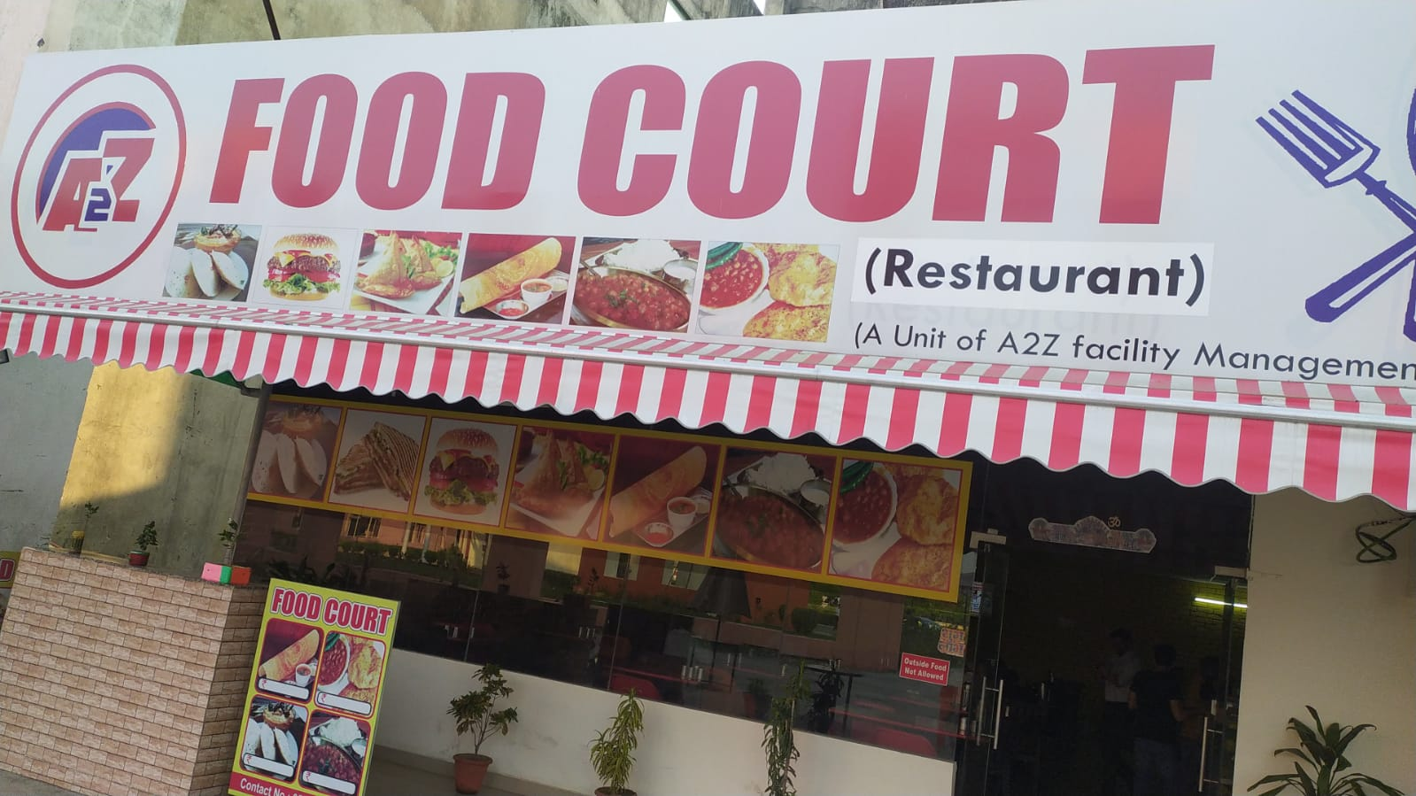
Organization Details
A2Z Food Court, a unit of A2Z Facility Management Services(A2Z FMS)
B2C(Business-to-Consumer)
Mr. Pradeep Panwar with his 2 co-founders
No. of Employes - 25
Working Time: 7:00 AM to 10:00 PM (15 hours)
Categories Available – Meals, Snacks, Uncategorized, Beverages, Miscellaneous and
Desserts.
Nearby State University – Lucknow, UP .
Problem Statements
A2Z Food Court's sales are mainly from a few items, limiting growth.
A2Z Food Court's high labor costs are affecting profits.
02

Slide 3
Dataset Details
Data Overview:
The dataset covers a one-year period (from October 1, 2023, to September 30, 2024).
Item-wise Sales Data: 100 rows and 8 columns – contains Item Name, Total Quantity(of 3-month interval) and Total Amount(of 3-month interval) columns.
Daily Sales Data: 367 rows and 2 columns – contains Date and Revenue(Rs.) columns.
Data Analyzed:
Item-wise Sales data: For ABC and Category-wise sales analysis – menu optimization.
Daily Sales data: For trend and weekday/weekend analysis – .Workforce Management
Tools Used:
MS Excel: Data collection, preparing the Data and cleaning the Data .
Python, Numpy, Pandas and Matplotlib: For Data Analysis and Visualization.
03

Slide 4
Analysis Methods
1. Trend Analysis (Time-Series): Analyzed monthly revenue trends to identify high and low-performing periods. Used line plots to capture revenue fluctuations and peak months (e.g., Aug–Sep, Jan lows).
2. Weekday vs Weekend Analysis: Compared average revenue between weekdays and weekends. Revealed student-driven patterns with stronger weekday performance (especially Mondays) and weak Sundays/festivals.
3. Quarterly Category-Wise Sales Analysis: Tracked total quantity sold across 4 quarters for each category (Meals, Beverages, etc.). Identified growth (Meals), decline (Desserts), and volatility (Uncategorized items) using line graphs.
4. ABC Classification: Segmented products into A, B, C categories based on their revenue contribution. Highlighted that only 19.2% of items (Category A) contribute nearly 80% of total revenue — focus items for strategy.
04

Slide 5
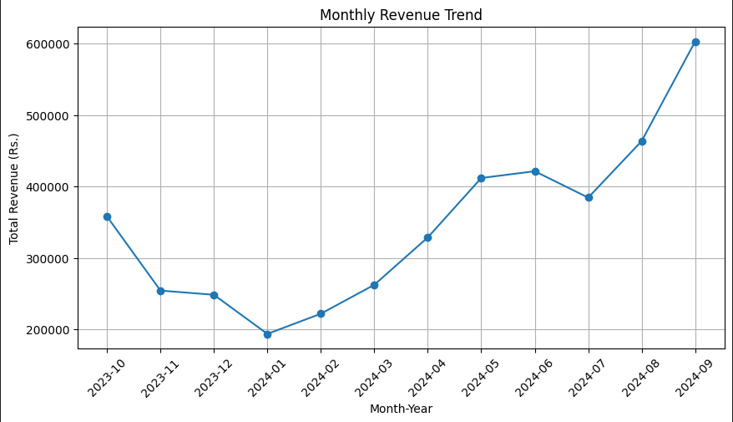
Trend Analysis
Avg Revenue = ₹11.3K/day, but ranges widely from ₹2.3K to ₹28K → sales are highly unpredictable.
January is Weakest: lowest and most stable revenue.
Feb–May = Predictable Growth: sales are steady with average variance → revenue is easier to estimate.
Aug–Sep = Artificial Peaks: High spikes in graph→ a few days had very high sales, rest remained normal.
05

Slide 6
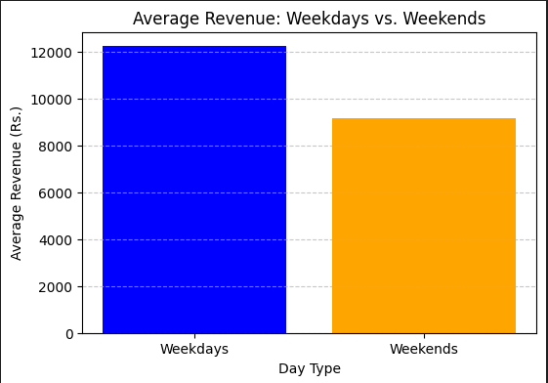
Weekdays VS Weekends
Weekdays perform better: Average revenue is ~₹12,200 on weekdays vs ~₹9,200 on weekends.
Monday is best, with the highest average revenue (~₹13,149).
Sunday is lowest, with just ~₹6,062 despite being open throughout the year.
This trend shows student-driven sales—weekdays are busy, weekends are slower.
Even on festivals/Sundays, sales stay low → likely due to students not visiting the campus.
06

Slide 7
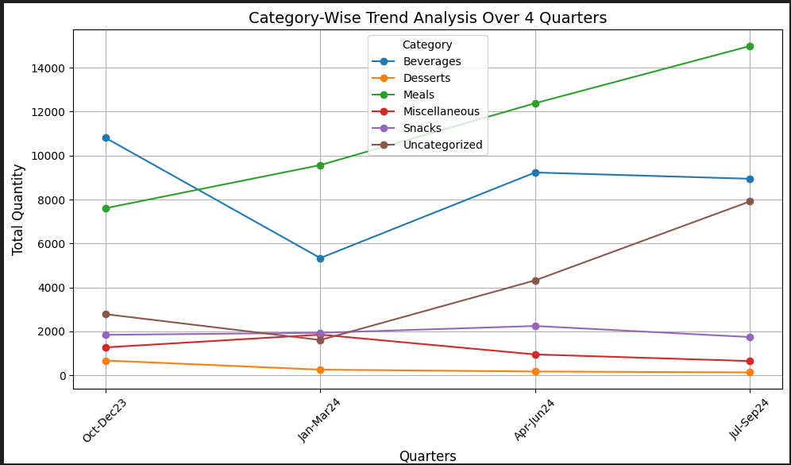
Category-Wise Trend Analysis Over 4 Quarters
Meals consistently rise every quarter — from ~7.5K to ~15K items.
Beverages fluctuate — strong in Q1, drop in Q2, partial recovery in Q3 & Q4.
Uncategorized items show rapid growth — from ~2.8K to ~8K.
Desserts & Miscellaneous decline steadily — sales dropped significantly, especially after Q2.
Snacks remain stable — moderate demand (~1.5K–2.2K range), with slight dip in Q4.
07

Slide 8
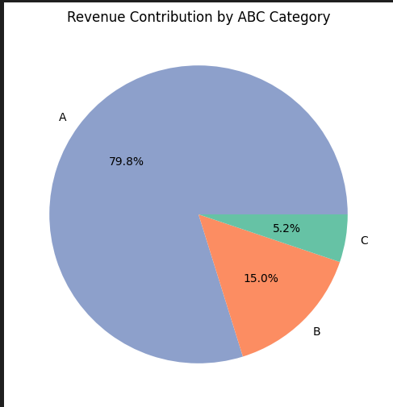
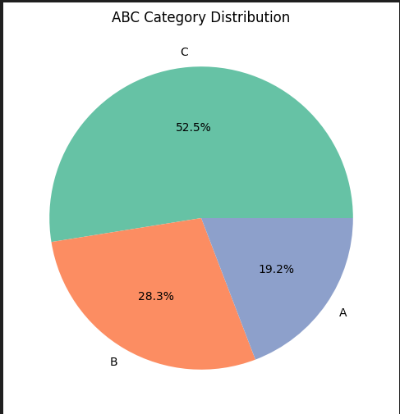
ABC Analysis
Category A: Only 19.2% of items, but contributes 79.8% of total revenue.
Category B: 28.3% of items, generating 15% of revenue.
Category C: 52.5% of items, but just 5.2% of revenue.
08

Slide 9
Recommendation
Boost Low-Selling Items with Meal Combos: Since most sales come from Meals and related items (like extra dal, rice, dahi), low-performing categories like Snacks, Desserts, and Miscellaneous can be paired as discounted combos. For example, instead of ₹200, offer a Meal + Snack at ₹185. This can increase sales of slow-moving items and also help identify which combos work well. Based on customer response, unpopular items can later be removed from the menu.
Maximize Fest Season Sales (Aug–Sep): Sales peak during college fests due to high student footfall. Start promoting early (June–July) through posters and student offers. During fest week, give loyalty discounts to regulars and introduce limited-time deals to attract new customers and boost overall revenue.
Reduce Costs on Low-Sales Days: Sundays and holidays have low sales but high operating costs due to double staff pay. Since college students (main customers) are usually absent, closing on these days can save up to ₹1 lakh/month without impacting overall sales much.
09

Slide 10

Thank You !
10

